Slide 1
Data Visualization Report –
Motor Vehicle Collisions

Slide 2
Problem Statement
We have been provided with a dataset containing information on Motor Vehicle Collisions - Crashes spanning from 2012 to 2024.
We need to create a visualization report focusing on the years 2018 to 2021.
The report should include insightful visualizations and data analysis to provide a comprehensive understanding of the trends and patterns within this timeframe.
Utilize appropriate visualization techniques to effectively represent the data.
Utilize only reasonable graphs or visualizations that provide meaningful insights.
Ensure the report is well-organized and clearly presents the findings to facilitate understanding.
Visualization report in PowerPoint format, with findings summarized below each graph.
We should perform data preprocessing, cleaning, and manipulation techniques if required before generating visualizations.

Slide 3
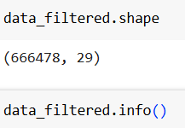
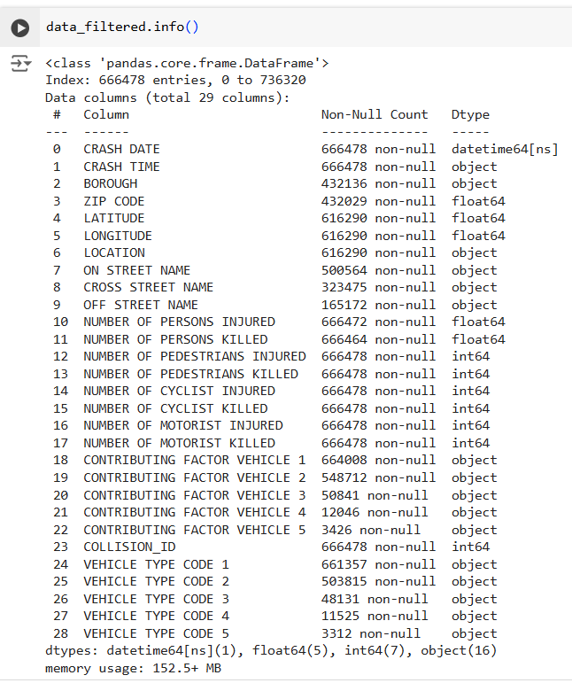
Exploratory Data Analysis
The Dataset Motor Vehicle Collisions - Crashes spanning from 2012 to 2024 contains 1048575 data points and 29 columns.
The filtered dataset over the period 2018 to 2021 contains 666478 data points and 29 columns

Slide 4
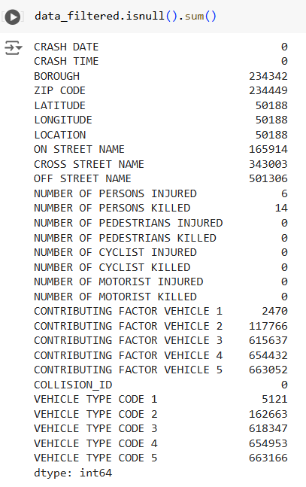
Data Preprocessing
The null/ missing entries of this dataset is shown below
Dropped the rows that have missing Borough, Zipcode, Latitude, Longitude and Location as these denotes the geographical data and are inevitable as we need to know the location of motor vehicle collision.

Slide 5
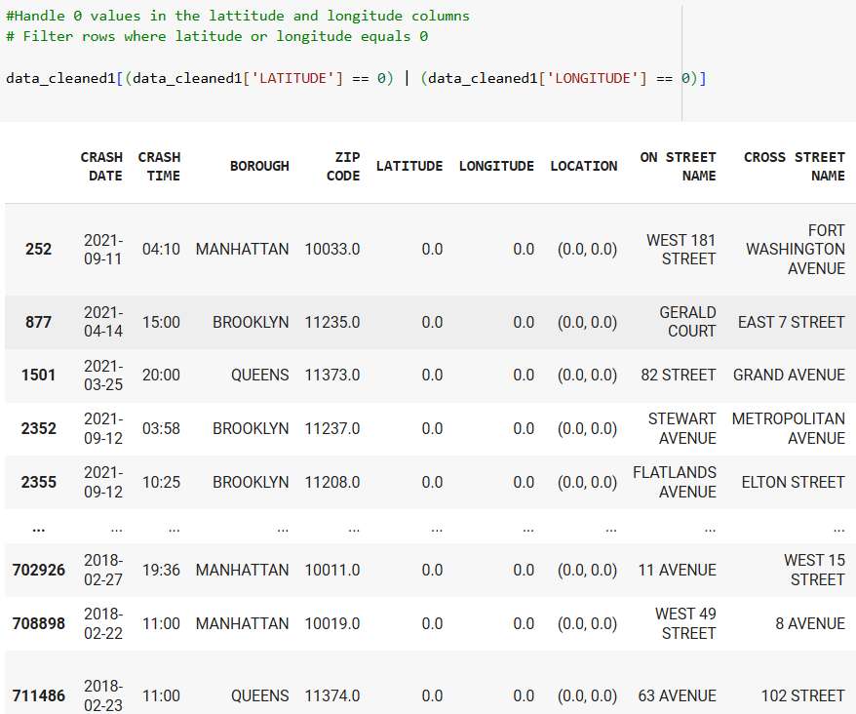
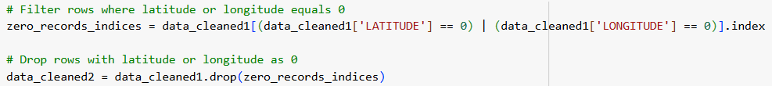
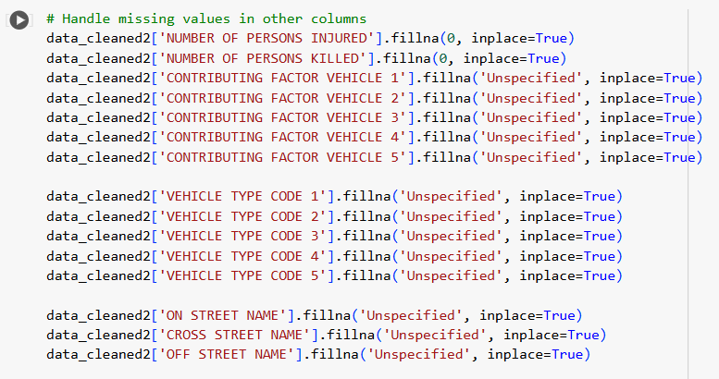
Handled the 0 value for the column Latitude and Longitude as it was not representing the zero coordinates in the map and hence it was representing the missing entries for these columns.
Handled the missing values in other columns by filling with the word ‘Unspecified’ and 0 according to their entries for the null values.

Slide 6
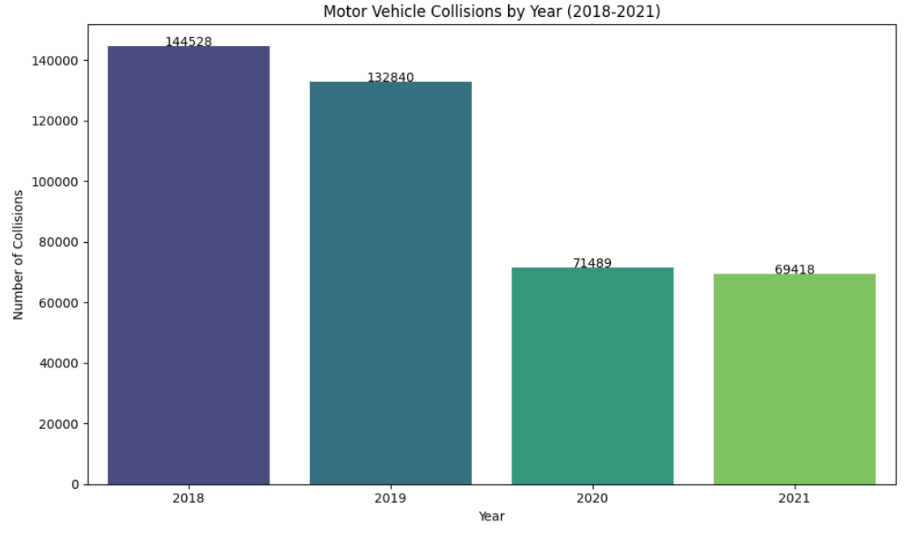
Number of Motor Vehicle Collisions per year - 2018 to 2021
Summary
The number of motor vehicle collisions are getting gradually decreasing over the time period.
Accidents were highest in the year 2018 and got gradually decreased to its 50% in the year 2021.
There is a huge difference in the accidents in the year 2019 to 2020.
This can be due to the strictening of motor vehicles rules and careful driving.

Slide 7
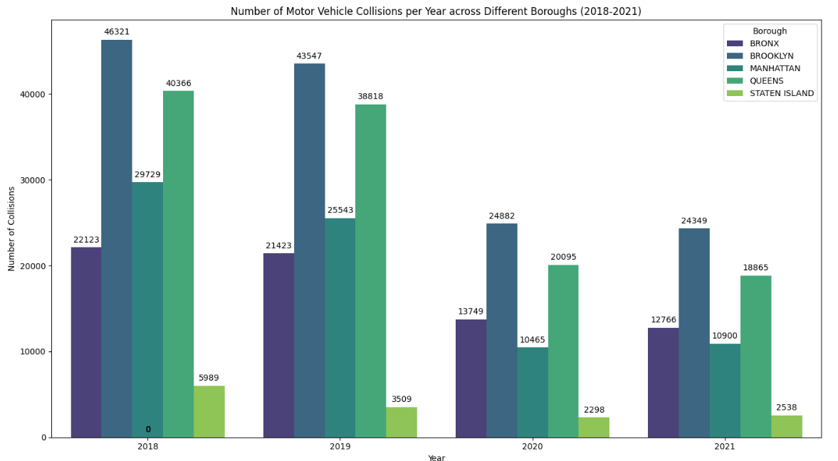
Number of Motor Vehicle Collisions per Year across different Boroughs
Insights:
Brooklyn Borough has the highest number of motor vehicle collisions and Queens borough has the second highest number of collisions. Staten Island has the lowest number of collisions.
Collisions are gradually decreasing over time.
Insights:

Slide 8
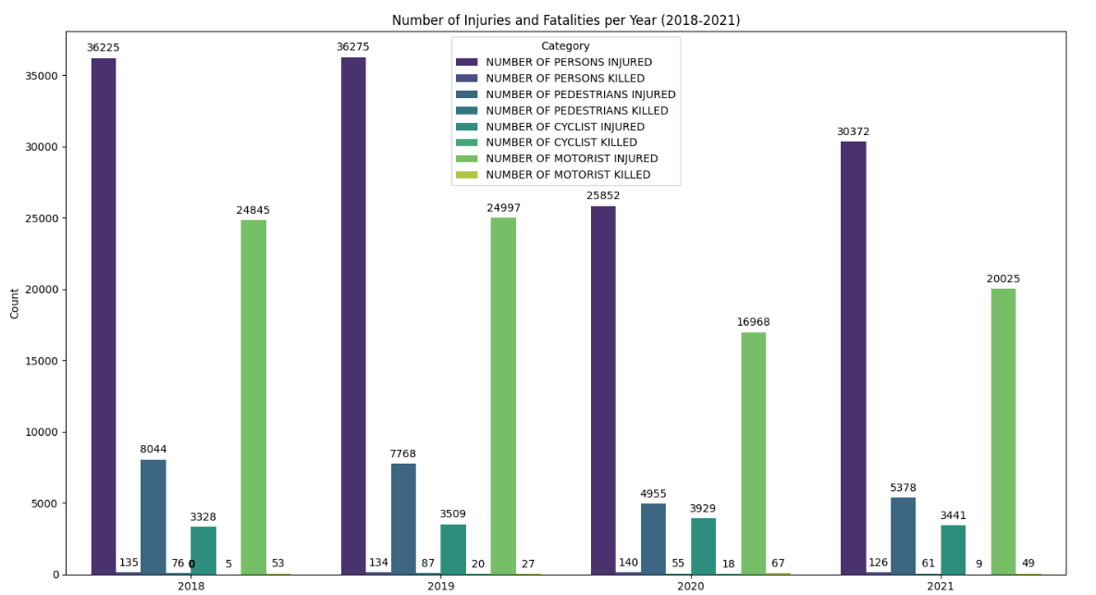
Number of Injuries and Fatalities per year
Insights:
Number of persons injured stands the highest among injured and fatalities category and number of motorist injured stands the second highest.
There is increase and decrease on these category over different time period

Slide 9
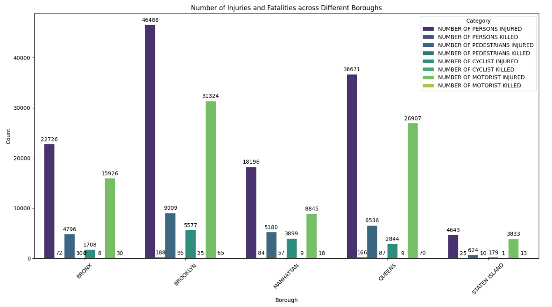
Number of Injuries and Fatalities across different Boroughs
Insights:
The highest number of persons injured and motorist injured during an accident belongs to Brooklyn Borough and Queens borough has the second highest number. Staten Island has the lowest number.
The probability of occurring highest number of accidents takes place in the Brooklyn Borough. So people in this borough should be careful in driving

Slide 10
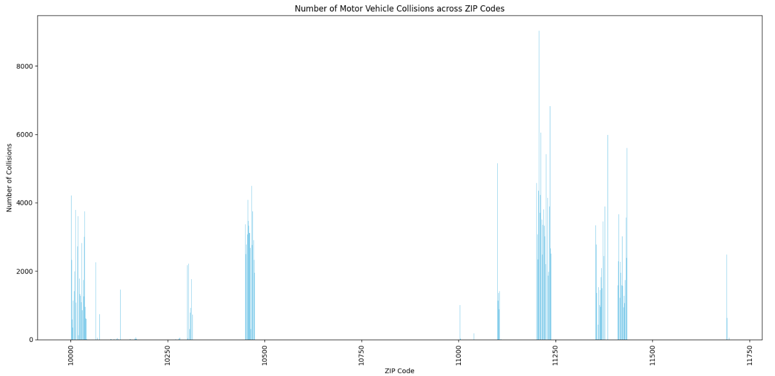
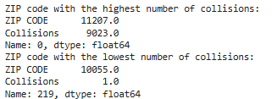
Total Profit for each Cab Company City Wise
Insights:
The zipcode where the accidents are frequently occurring is 11207. There had a total of 9023 accidents over the period 2018 to 2021.
And the zipcode with lowest number of accidents occurring is 10055 which had only 1 accident during this period.

Slide 11

.
Thank You

